Slide 1
Structuring (Large) OO Systems
Architecting an object-oriented system for size, clarity, reuse, extensibility and collaboration
Advanced Software Engineering 475
Andrew McVeigh

Slide 2
What is System Structure?
We are interested in how a system is logically organised
  How classes and interfaces depend on each other
  How the modules / packages are related and organised
Why bother to structure well?
  The larger the system the more complex it can become
  A well-designed structure is vital for managing this complexity
The consequences of bad structure...
  Wasted time trying to understand a complex system
  Difficult (sometimes impossible!) to add to or enhance a system
  Poor reliability as it grows so complex it cannot be maintained

Slide 3
Structuring a System Well
How you structure a system affects:
  How understandable it is to others
  How easy it is to maintain and enhance
  Whether parts of the system can be easily reused
  How easily it can be extended by other programmers
  How people working on the system collaborate and communicate
Well-structured systems follow a few basic concepts
  Learn how to apply these to create well-structured systems or repair badly structured ones
  As a system grows larger, these become more important
  The concepts are distilled from many years experience on systems in many domains

Slide 4
Background
My background (Andrew McVeigh)
  Architected and developed a number of large OO systems
  Systems of ~1MLOC size, £X0m+ budget, 30+ developers
  Some of these systems have been live for ≥ 10 years
  Multiple teams working on the same system
This material comes from:
  Systems I have architected or developed in finance, telephony, smartcards, digital broadcasting, speech processing...
  Robert Martin's ”Design Principles & Design Patterns” aka SOLID
  http://www.objectmentor.com/resources/articles/Principles_and_Patterns.pdf
  My research on architecture and components
  http://portal.acm.org/citation.cfm?id=1181206http://www.javalobby.org/articles/di-heritage/

Slide 5
The Core Structuring Concepts
Dependency principles
  Avoiding cycles
  The abstract client pattern
  The abstract server pattern
  Dependency inversion and injection
Modularity and large-scale reuse
  Layers
  The open-closed principle and frameworks
Structuring for collaboration
  Interfaces and contracts for separation

Slide 6
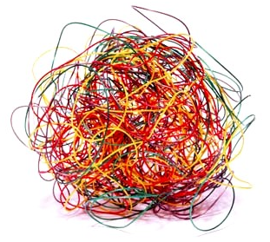
Dependency Principles
  (or how not to create
  a ”big ball of mud”)

Slide 7

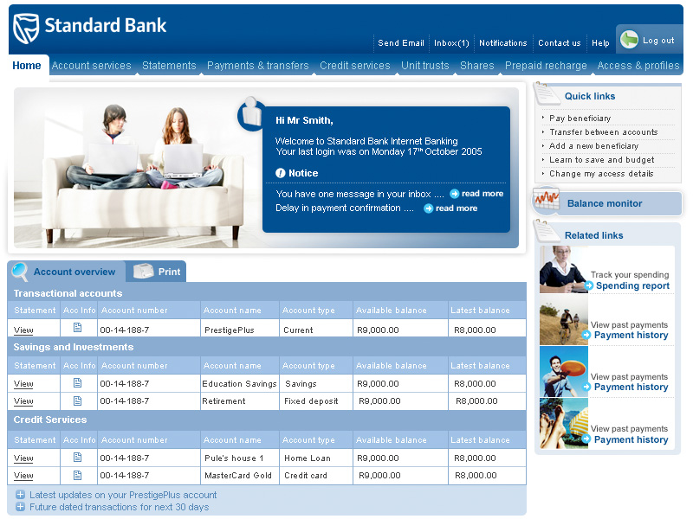

Example: Loading Apps onto Smartcards
A bank wants people to be able to load applications onto their smartcards, via the internet
online banking site
customer
downloads
applications
onto
smartcard
via reader
Notes:
Things affected:
1. reuse
2. understanding – where do you start?
3. maintainability – what effect does a change have?

Slide 8
A package for each major abstraction
what are the relationships between the abstractions?
Notes:
Things affected:
1. reuse
2. understanding – where do you start?
3. maintainability – what effect does a change have?

Slide 9
But, cycles make it hard to understand
Consider trying to understand an early version of the smartcard system with cyclical dependencies
A single entity cannot be understood or reused in isolation if there are cycles --> where do you start?!
Notes:
Things affected:
1. reuse
2. understanding – where do you start?
3. maintainability – what effect does a change have?

Slide 10
An example of a cycle
public class SmartCard
{
  private String cardNumber;
  private Cardholder owner
  ...
}
public class Cardholder
{
  private String name;
  private List<SmartCard> cards = new ArrayList<SmartCard>();
  ...
}

Slide 11
Avoiding cycles gives clarity
No cycles = concepts can be explained in graph order
i.e. a request is for a product for a cardholder. a cardholder has a set of smartcards. applications are delivered onto a smartcard via a delivery channel.

Slide 12
Packages, Modules, Namespaces...
What do we mean by a package/module/namespace?
  A construct that groups classes and interfaces
  Declares (possibly implicitly) dependencies on other packages/modules/namespaces
  Possibly nested (e.g. Java packages)
May declare explicit (modules) or implicit dependencies (Java packages)
  E.g. Java classes inside the packages create dependencies for the package.
These are a coarse-grained unit of reuse
Cycles prevent reuse of these coarse-grained units
  Cycles between classes are often less significant

Slide 13
Acyclic dependencies aid reuse
When no cycles exist, units can be reused in graph order
dependencies

Slide 14
Reuse of lower layers
E.g. if dependencies are acyclic, we can reuse smartcard and delivery channels in another application
dependencies
Lower layers have no
knowledge of upper
layers...

Slide 15
How do cycles between units occur?
Look specifically at the relationship between smartcards and their application delivery channels
An early version of the software had a cyclic dependency which prevented reuse of each element individually
How did this occur, and how do we fix it?

Slide 16
Cycles start at class level...
E.g. A smartcard uses a delivery channel to deliver applications to the card
But, the channel needs to inform the system/card when it has delivered the application
class SmartCard {
void deliverApp(OnlineDeliveryChannel c)
{
...
}
}
class OnlineDeliveryChannel {
SmartCard cardsToNotify[];
...
}
the channel
notifies the card
when the apps
are loaded
the smartcard
asks for an app
to be delivered

Slide 17
Class cycles then lead to bigger cycles
the two packages are now tightly coupled
  We don't want to put them in the same package, as this leads to a monolithic design
  But, even if we put them into two separate packages, we get a package cycle
  Eventually leads to ”Big Ball of Mud” anti-pattern
  http://www.laputan.org/mud/mud.html#BigBallOfMud
  This is the structural equivalent of spaghetti code
  A ”Big Ball of Mud” system will overwhelm even the most experienced & talented engineers
  The best way forward is to ”untangle it” using the following dependency structuring patterns...

Slide 18
Why should we care about reuse?
Why is it bad that smartcard and delivery are coupled?
  Answer: Each layer of software is useful in its own right
  E.g. We want to use the application delivery channel with mobile SIM cards rather than bank-issued credit cards
We can only do this if we can separate out cards and the delivery channel
mobile SIM cards
dependencies
application delivery channel

Slide 19
Untangling Pattern #1: Abstract Client
To untangle, we make an abstract client, using an interface
  A bit like a low-level form of the ”observer pattern”
A smartcard is one specific implementation of the abstract client
The channel only knows about abstract clients, not smartcards...

Slide 20
Abstract Clients continued...
This has fixed the problem between packages also...
package smartcard;
class SmartCard implements AbstractClient
{
void deliverApplication(OnlineDeliveryChannel c)
{
...
}
}
package applicationdeliverychannel;
class OnlineDeliveryChannel
{
ApplicationClient clientsToNotify[];
...
}

Slide 21
What about decoupling the other way?
What if we want to use smartcards with a different delivery channel?
  i.e. application delivery at a cash machine
  The problem is that smartcard depends explicitly upon the online delivery channel abstraction!
??

Slide 22
Untangling Pattern #2: Abstract Server
We make an abstract ”server”, using an interface
  Basic polymorphism – smartcard just uses a ”delivery channel”
Smartcard only knows about channels, not specific channel implementations

Slide 23
Putting it all together...
Abstract client + abstract server allows the smartcard and concrete delivery packages to be independent
  they can be reused in different contexts
Implements AbstractClient
Uses AbstractServer
Implements AbstractServer
Uses AbstractClient

Slide 24
Putting it all together... (continued)
For instance, we can configure a smartcard online system only, by using smartcard + online delivery
Or we can configure a cash machine system only, by choosing to include smartcard + cash machine delivery

Slide 25
Dependency Injection Pattern
Q: But who makes the connection between the
concrete smartcard and the delivery channel?
A: Someone higher up ”injects the dependencies”...
  This has become a popular style in Java
  Easy to do via code
  Also supported by various libraries that use XML or annotations to make the connections (e.g. www.springframework.org)
class Application {
public static void main()
{
SmartCard s = new SmartCard();
AbstractDeliveryChannel c = new CashMachineDeliveryChannel();
s.setDeliveryChannel(c);
...
}
}
Dependencies are ”injected” by glue code...

Slide 26
Dependency Injection Aids Unit Testing
There is now no explicit object creation code in Smartcard or the DeliveryChannels
  ”Wire up” a different arrangement to test Smartcard in isolation
A dummy delivery channel we have created for testing
class SmartcardTests
{
@Test
public void testCard
{
SmartCard s = new SmartCard();
AbstractDeliveryChannel c = new TestDeliveryChannel();
s.setDeliveryChannel(c);
...
s.addApplication(...);
Assert.assertEquals(...);
}
}
We are testing smartcard, using a pretend delivery channel

Slide 27
Summary of Dependency Principles
Use these principles to create an acyclic logical structure
  Abstract client – insulates ”server” classes against concrete clients
  Abstract server – insulates ”client” classes against concrete servers
  Dependency inversion – depend on abstractions rather than concretions
  Dependency injection – connect the concrete instances together at a ”higher level”
Structure packages / namespaces to avoid cycles
  Promotes understanding – concepts can be understood in graph order
  Promotes unit testing & context independence of classes
  Promotes reuse – packages can be used in isolation
  Good for maintenance – know the impact on other parts of the system

Slide 28
Some dependency management tools
Free tools:
  JDepend
  http://clarkware.com/software/JDepend.html
  Allows dependency cycles to be analysed + lots of other metrics
  Architecture Rules
  http://72miles.com/architecturerules/
  Allows dependency rules to be set up for Java; uses JDepend
  Eclipse
  http://www.eclipse.org
  Structure software as multiple projects to get cycle checking
Commercial tools:
  Structure101
  http://www.headwaysoftware.com/products/structure101/index.php
  Graphical analysis of Java structural dependencies
  Stan4J
  http://www.stan4j.com
  Graphical analysis of Java structural dependencies; nicer graphs
  Ndepend
  http://www.ndepend.com
  Nice graphical analysis of .Net structure, with query language

Slide 29
Resources on Dependency Injection (DI)
Explanation of DI
  http://martinfowler.com/articles/injection.html
DI as a simplied, restricted component system
  http://www.javalobby.org/articles/di-heritage/
Some DI ”containers”: libraries to simplify injection
  Spring framework: Java & .Net
  http://www.springframework.org
  The Windsor and Castle projects for .Net
  http://www.castleproject.org/container/index.html
Darwin and Conic Architecture Description Languages
  Imperial-developed component systems that are supersets of DI
  About 20 years ahead of their time...
  http://portal.acm.org/citation.cfm?coll=GUIDE&dl=GUIDE&id=4111http://citeseer.ist.psu.edu/magee94regis.html

Slide 30

Modularity and Large-Scale Reuse
Layers

Slide 31
Software Layers
Structure a system as a set of layered abstractions
Each layer uses the services beneath it
Can have strict or relaxed variants
  Relaxed means that a layer can use any layers below it
  Strict means that a layer can only use the layer directly below
  See: Pattern-Oriented Software Architecture, Volume 1
  A System of Patterns; Buschmann et al
This is a powerful way to structure a system
  ”A system that works is build on top of a smaller system that works”
Layered systems are a bit
like geographical strata.
Each layer builds on those
below...

Slide 32
Structuring Software Layers
Each layer should have an API
  The ”application programming interface” (API) is a set of interfaces & classes
  Clients use the API to perform services
  The layer implements the services
  We can change the implentation later as long as the API stays constant
  Heavy use of abstract server concepts

Slide 33
A Well-Known Example of Layering
GUI toolkits
  Underlying change of layer doesn't affect upper clients who program to the API
The portability of the GUI app depends how far down into the lower level layers it reaches...
E.g. reaching into the X11 or Win32 layer is bad for portability.
Unix
Windows
SWT/Windows

Slide 34
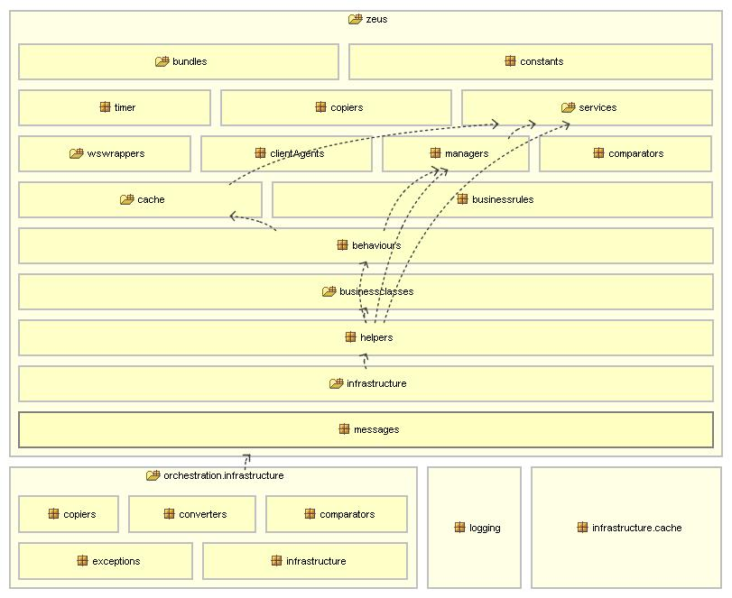
Layering of an Banking System
Banking system
About 500kLoc
Note the cycles.
This made it
harder to
maintain,
understand
and build.

Slide 35
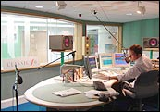
Layering of a Digital Audio System
Console Screens
250kloc
C/C++
VME-based embedded system
running a real-time OS
Login System
Desk and Fader (Volume) Control
Audio Scheduler
Device Control
Audio Control
Real-time framework

Slide 36

Structuring for Collaboration
Interfaces and contracts for separation

Slide 37
Collaboration
Consider a team size of 20 people
Both are working on the smartcard problem
How can we divide them into 2 teams in 2 different countries?
  Working on the same codebase is difficult
Solution:
  Divide the code into areas of ownership
  Establish strong contracts via interfaces between the areas
  Use abstract client and abstract server to get dependencies in 1 direction only
Contract
Area 1
Area 2
Dependency direction

Slide 38
Dividing up the smartcard example
Team A
// abstract server
interface DeliveryChannel
{ ... }
// abstract client
interface DeliveryWatcher
{ ... }
Team B

Slide 39
Dividing up the smartcard example
This was the actual division chosen
  It turned out that delivery was a major part of the application
  Team A's system knew about Team B's system
  Team B wrote an interface document using abstract client and server principles
    Interface was actually over RMI (EJB)
  The teams would discuss (argue?) about the interfaces, but they could work independently
  Great success – each system delivered on time and to spec
    and I was able to hand over the delivery system to another architect
Conclusion:
  Sometimes it makes sense to segregate the system via these principles to reflect teams and communication lines
  Interfaces and the 2 decoupling patterns are the key

Slide 40
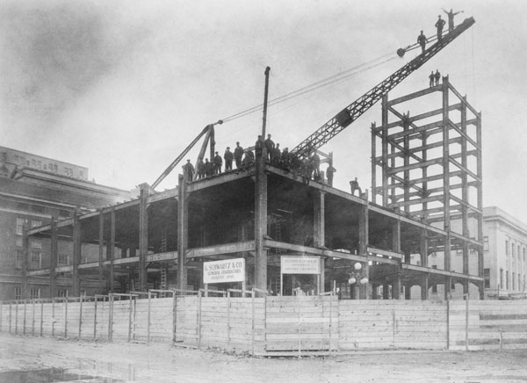
Modularity and Large-Scale Reuse
Frameworks and the Open/Closed Principle

Slide 41
Building a Smartcard Application
The process of building a Smartcard application is complex
  It varies by bank and by smartcard operating system
The steps are roughly:
  Choose an application
  Gather the data for an application from data sources
  Build an application
  Package and encrypt the application
  Deliver it onto a smartcard
The process of building an application is complex
  Data sources and encryption varies by bank and smartcard OS
  Application building often varies by application and OS
  How do we express the commonality, but provide the flexibility

Slide 42
A Naive Approach...
The initial class model looked like this for a single card issuer, with a single application, on a single card OS

Slide 43
Control of Flow...
A key point here is that the Request and Coordinator control the program flow and have a lot of logic
  We pass control over to them and they build the app and deliver it
  How can we reuse this structure but allow for all possible variation?
  How can we intervene for the different types of app etc.?

Slide 44
A Framework: Step1 = Interfaces
To make it into a framework, we place interfaces at each point of variation

Slide 45
A Framework: Step2 = Registry
We need a way to select concrete implementations based on criteria
One way is to use a registry for each variation point
  Clients register concrete implementations
  The framework queries for implementations using criteria
Code for the client:
appRegistry.register(”multos”, ”EMV”,
new MultosEMVApplicationBuilder());
appRegistry.register(”javacard”, ”Loyalty”,
new JavacardLoyaltyBuilder());
...
Code inside the coordinator:
void build(String os, String app)
{
...
appRegistry.queryBuilder(os, app).
buildWithImage(...);
...
}

Slide 46
Putting It All Together
How a framework operates:
  client registers implementations with framework
  client hands over control to framework
  framework calls out to client implementations at various points in its processing
  framework (usually) exits after processing is finished
client
implementations are
registered (1)
enter (2)
framework
processing
logic(3)
calls out
when needed (3)
exit (4)

Slide 47
Java Swing Framework Example
public class ButtonTest {
public static void main(String args[]) {
// register our graph of UI components
JFrame f = new JFrame("ButtonTest");
f.setDefaultCloseOperation(JFrame.EXIT_ON_CLOSE);
JButton button = new JButton("Press me");
button.addActionListener(new ActionListener()
{
public void actionPerformed(ActionEvent e) {
System.out.println("$$ you pressed the button!");
} });
f.add(button);
f.pack();
// pass over processing to the swing framework
f.setVisible(true);
}
}

Slide 48
The Open / Closed Principle
The Open / Closed principle states:
”A module should be open for extension
but closed for modification”
Frameworks obey this characteristic
  You extend the framework by registering concrete classes with it
  The frameworks processing is affected by what you register
  You don't have to modify the framework directly
Frameworks are said to operate according to the Hollywood principle:
”Don't call us, we'll call you”
This is also known as inversion of control

Slide 49
Framework Characteristics & Dangers
A framework is like a reusable ”mechanism”
  Can scale to large sizes
  Can have ”frameworks layered on top of frameworks”
  Frameworks can be packaged and sold as entities
Framework drawbacks
  Can be hard for others to learn
  Embeds processing logic which is hard to modify
  Controls program flow
  Require possibly too much prediction of variation points
  Need to refactor to support new abstractions – breaks old clients
  ”A framework isn't reusable until it has 3 separate clients”

Slide 50
Framework Examples
Smartcards
  Variations for bank, application, smartcard OS, encryption
  ~1MLOC. Large-ish project: 30 developers over 3 years initially
  Customised for a number of banks and demonstrations
  Refactored out of a system for a single bank
  Still sold after 10 years
Digital Audio Desk for broadcasting
  Variations for different devices (control, audio) and broadcast hardware
  Layered frameworks: an audio control system over a real-time framework for task management
  20 developers over 2-3 years; critical real-time system

Slide 51
Modularity and Large-Scale Reuse
A Simple Framework Process

Slide 52
A Simple Framework Process
A process to avoid common framework pitfalls
The process
  Start with a concrete system with natural variation points
  Introduce new variation points and concepts as needed
  Introduce classes to help existing users migrate
  Refactor as needed, with lots of unit-tests for regression
The key is to avoid too much ”prediction”
  Don't overengineer
  But don't ignore obvious variation
  Important to get a balance...

Slide 53
Frameworks are useful and common...
...but frameworks are difficult to make and use
  Too much prediction required for extension points
  Difficult to evolve
  Every framework user has to use the same extension points
  Integrating two frameworks is very difficult

Slide 54
Consider the forces of use/reuse...
Consider the viewpoints of the developers / reusers
Fred: Reuser
Wants extra extension point
and integration with another
framework
Lily: Reuser
Wants modifications to
framework logic
Bob: Reuser
Happy with system,
wants NO changes but
does want fixes...
Extension pt 2
Extension pt 3
Extension pt 1
Kim: F'work developer
Wants to concentrate
on framework, without
incorporating every
change needed...
Framework

Slide 55
Consider when framework changes...
Fred: Reuser
I got my changes, but
framework logic has
changed!!!
Lily: Reuser
I got the framework
logic changed, but
lots of extra changes too
Bob: Reuser
I got my fixes, but
lots of changes ==
lots of work for me!
Version 1.0
Version 2.0
Changed extension point
Kim: F'work developer
I'm overworked and
underappreciated!
Changed logic
Added extension point

Slide 56
Food for thought...
Wider questions:
Are development tools, languages and processes biased towards creation only?
  Why do we have to predict extension points!
  Can we allow reusers to alter, but still preserve a common base?
  Is text-based version control and evolution the only solution?
  Do our languages allow too much freedom to create complex dependencies and make maintenance difficult?
  Can we do better and resolve these forces?

Slide 57
Some good and bad examples...
Dependency structure of well-known systems*
*graphed using Structure101

Slide 58
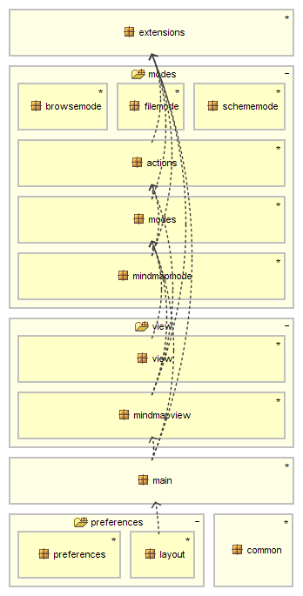
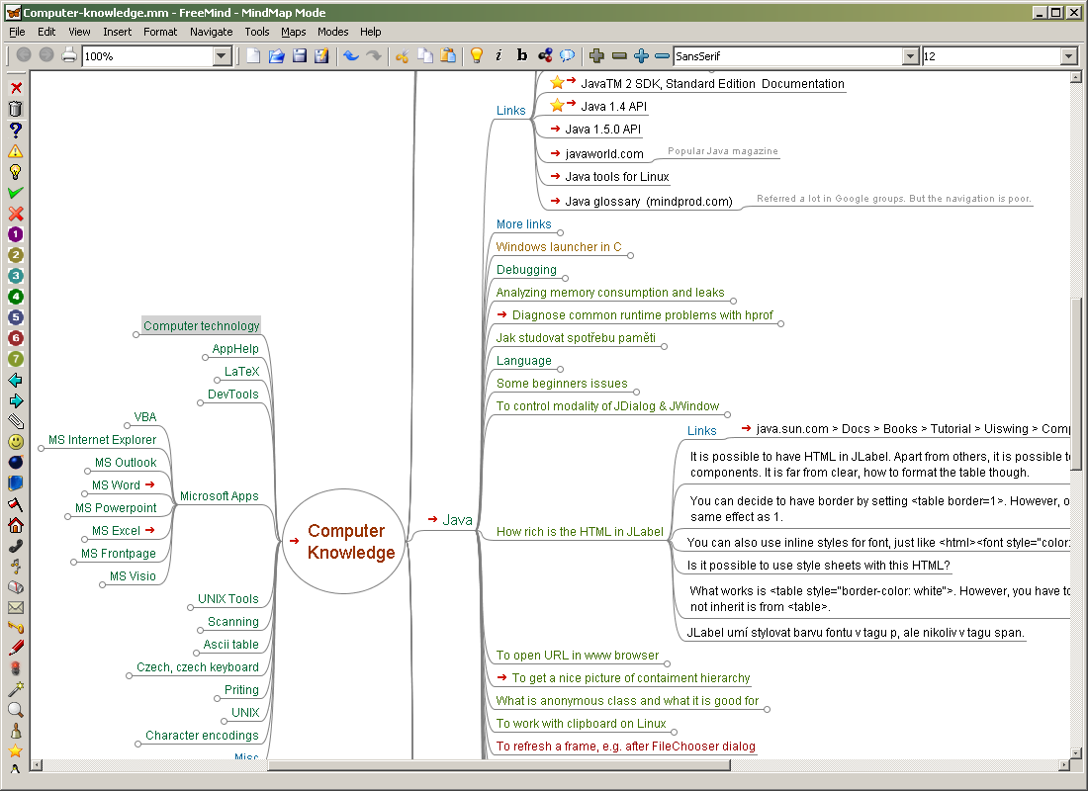
FreeMind
www.freemind.org
  about 61kloc
  mindmap software in java
Structured poorly...
  It's actually worse than i could show
  I wouldn't like to work on it...

Slide 59
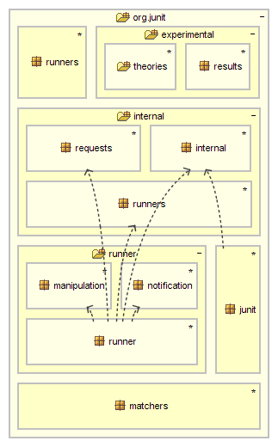
Junit
About 4kloc
Some circularity
junit pkg has annotations
but the dependency chain is:
  junit -> internal -> notification, runner -> requests -> manipulation, internal -> ...
A little ball of mud...
It's ok, though because junit is so small

Slide 60
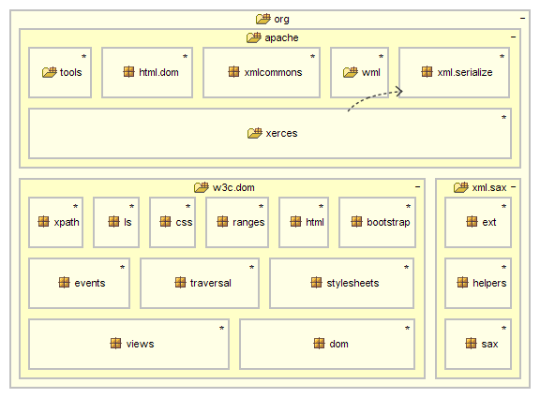
Apache Xerces and XML parsers
Very nicely layered – 1 tiny bad dependency
  Some serious efforts here to keep a good architecture

Slide 61
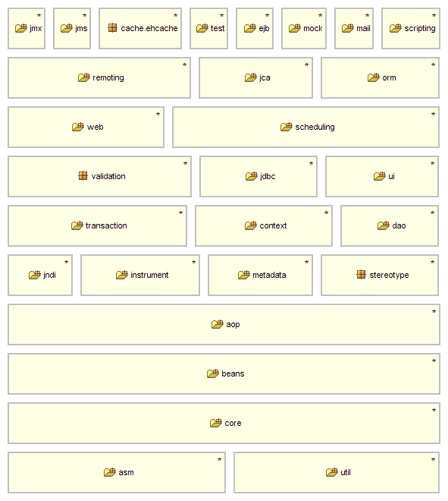
Spring: springframework.org
About 125kloc++
No cycles anywhere, at any depth
  Astonishing attention to dependency principles...
SpringWebflow also has no cycles...
There's a strong indication of quality here...

Slide 62
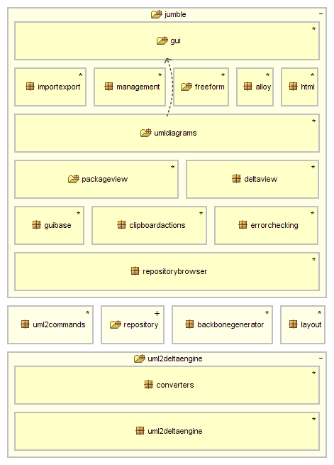
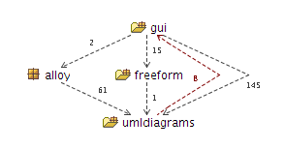
My CASE tool
~90kloc
Some bad dependencies
  Even when you are watching out, it's easy to get it wrong... :-(
  104 bad dependencies I need to sort out...

